Slide 1

ECommerce Analytics
Customer segmenting through RFM & Clustering
PREPARED BY:
Saitej
Akshay Chandrashekar Rao
Subakaran C
Raghavendra Das
Vishal Kaatiyar

Slide 2
Agenda
In this project, we will analyze and segment the customers of an e-commerce company by using the RFM approach. This will enable the e-commerce company to optimize their retention and acquisition strategies.
Problem
A single file has been provided which contains data related to the e-commerce transactions. This data contains the Customer IDs, Item code, Invoice Nos, Date-time of purchase, Customer shipping location, Quantity and Price from 2016 to 2017.
Objective
Build an unsupervised learning model which can enable the company to segment their customers via RFM (Recency, Frequency and Monetary value) approach and maximize sales & profit by focusing marketing efforts on our most valued customers.

Slide 3

EXPLORATORY DATA ANALYSIS

Slide 4
Data Understanding
Given excel file consists of 537979 rows & 12 columns in which following has Null values:
CustomerID 133790
Item Code 0
InvoiceNo 0
PurchaseDate 0
Quantity 0
Time 0
UnitPrice 0
Price 0
Shipping Location 0
Cancelled_status 529634
Reason of return 537976
Sold as set 537979
Unique Customer IDs
- Before Data cleaning* - 4349
- After Data cleaning - 4324
*includes outlier treatment and removal of negative values from 'Quantity' column.
A total of 9503 rows were found to have negative values which we have been excluded from this analysis.
Last three columns i.e. Cancelled_status, Reason of return & sold as set has been dropped out because 98.42%, 99.99% & 100% of the rows respectively are having missing values. Also, none of the rows of ‘Cancelled_status’ and ‘Reason of return’ columns remain after negative value treatment of Quantity column/variable.
The missing values of ‘Customer ID’ column have not been included in this analysis.
Reason: Since our effort is to identify the customer segments, the data points of unidentified customers won’t be useful for analyzing.

Slide 5
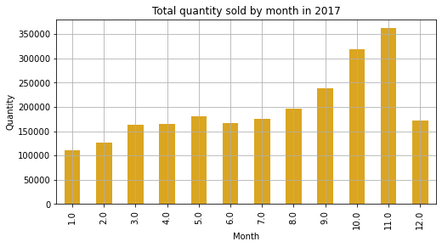
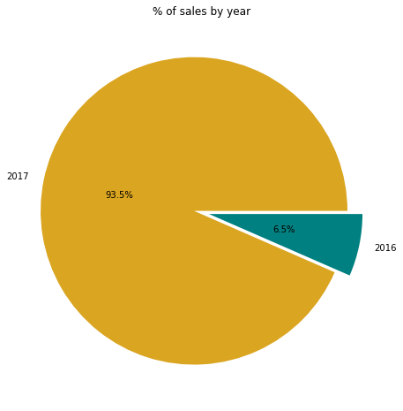
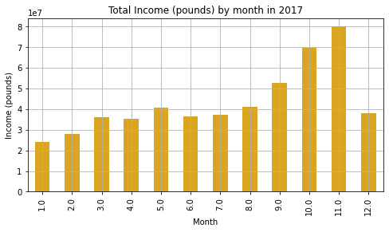
Bifurcating the sales according to Years & Months

Slide 6
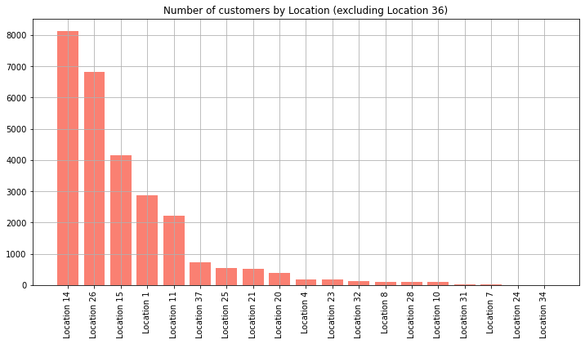
Bifurcating according to Shipping Location
Out of the 20 locations, Location 36 alone covers 93% of the total number of customers.

Slide 7

COMPUTING RFM SCORES

Slide 8
RFM (Recency , Frequency & Monetary) Analysis: RFM analysis is a customer segmentation technique used to prioritize customers. It uses three key data points—recency, frequency, and monetary value—to create a scoring system that segments customers into groups based on their value to a company.
Recency: Recency is calculated based on how long it’s been since a customer’s last purchase.
Frequency: Frequency is the number of purchases a customer has made in a specific time frame.
Monetary: Monetary value is simply the amount a customer spends on your product or service within a given time frame.
Recency
Reference Date & Last Invoice Date of each Customer ID
Frequency
Invoice Nos.
Monetary
Price (Quantity *Price per unit)
Note: All variables considered for computation are grouped by Customer IDs.

Slide 9
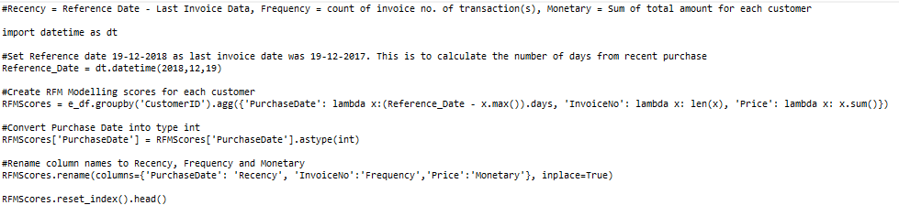
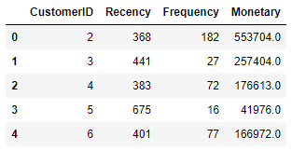
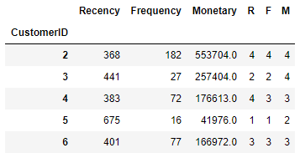
RFM Calculation:
Now splitting the RFM into four segments using quartiles

Slide 10
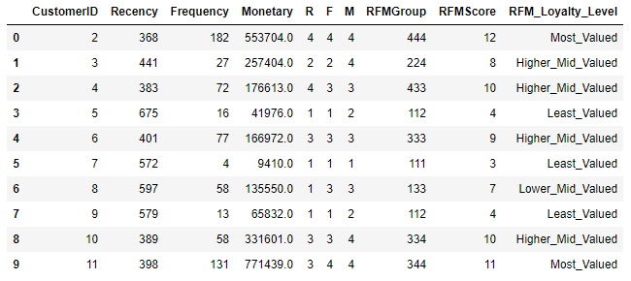
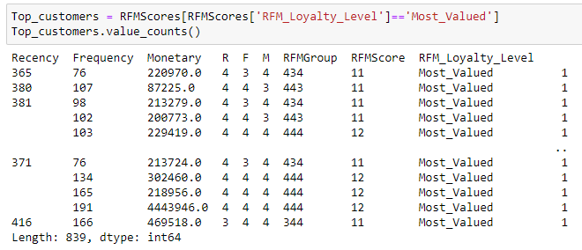
Calculating RFM merged value then assigning the loyalty level to the customers & validating the RFM Group
Finding the top customers

Slide 11
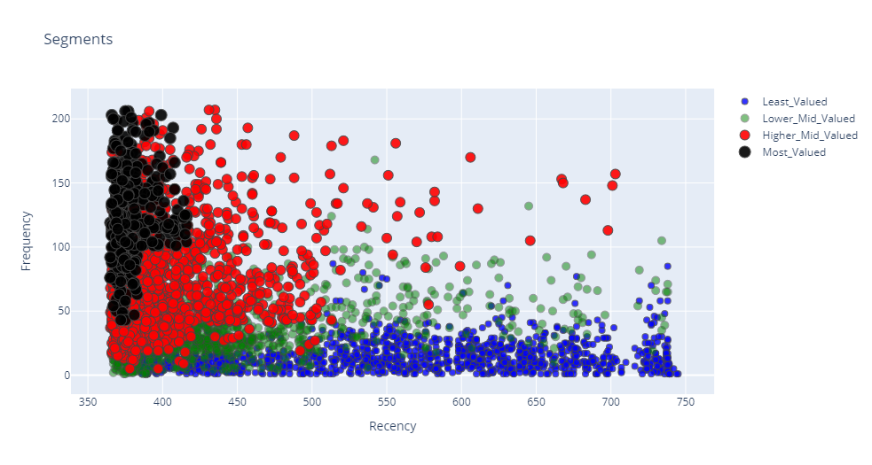
Customer segmentation: Frequency vs Recency

Slide 12
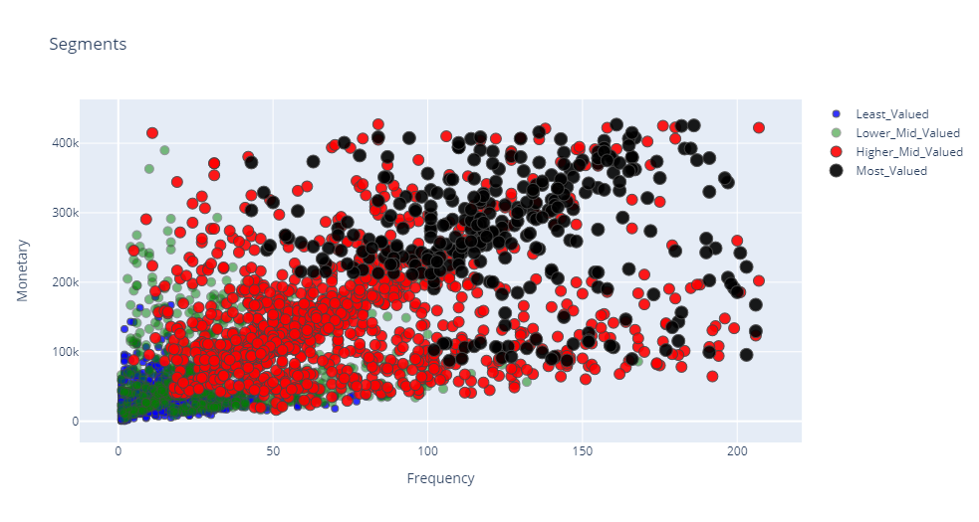
Customer segmentation: Monetary vs Frequency

Slide 13
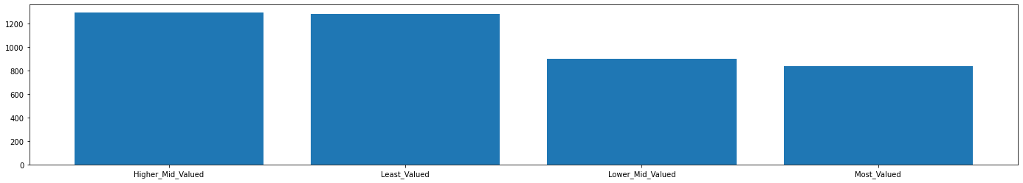
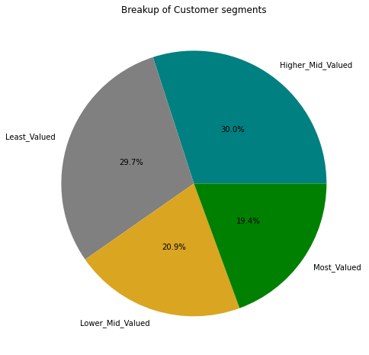

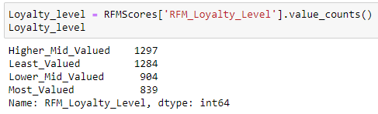
Customer segmentation according to RFM approach

Slide 14
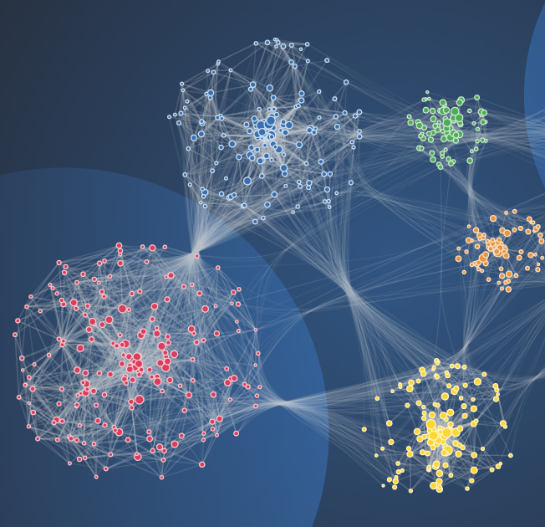
CLUSTERING

Slide 15
Cluster Analysis
Clustering
Exclusive Clustering
K-Means
Overlapping Clustering
Hierarchical Clustering
E.g. Fuzzy, c-Means, etc.
E.g. Linkage, Minimum distance, etc.
Deriving Clusters and Assessing Overall Fit
Decide on Clustering Algorithm
Many algorithms are available
More coming all the time
Main goal: Maximize differences between clusters relative to variation within clusters
What is K-Means Clustering?
K-Means is a clustering algorithm which focuses on grouping similar elements or data points into cluster.

Slide 16
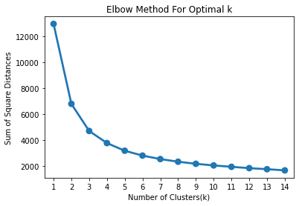
How to decide the value of K: Elbow Method
The Elbow Method looks at the total WSS as a function of the number of clusters.
Number of clusters should be chosen so that on adding another cluster doesn’t improve the total WSS.
Here we found K = 3.

Slide 17
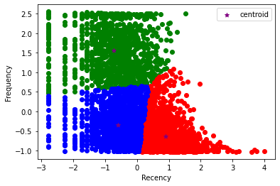
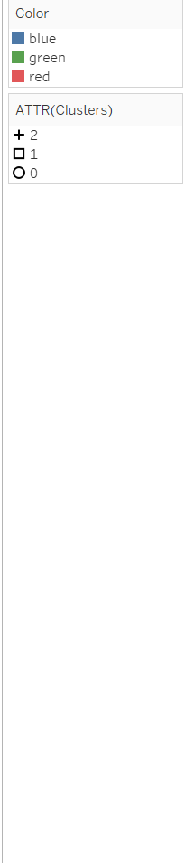
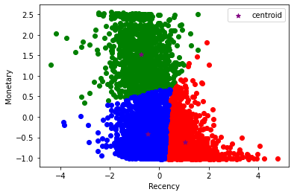
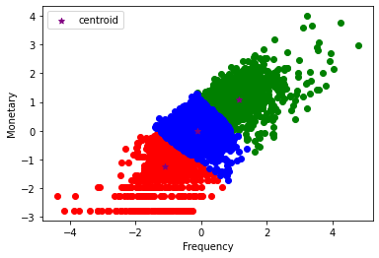

Slide 18


Slide 19
Management Recommendations
Shift all Marketing Time, Efforts and Budgetary allocation from Least Valued to Mid Valued.
Continue with the same existing Marketing efforts & Budgetary allocation for Most Valued.
Offer more premium products to Most Valued.
Offer discounted products to Mid Valued.
Increase Budgetary allocation for Mid Valued and induce them to become Most Valued by coming up with more Marketing campaigns and strategies dedicated for them.

Slide 20
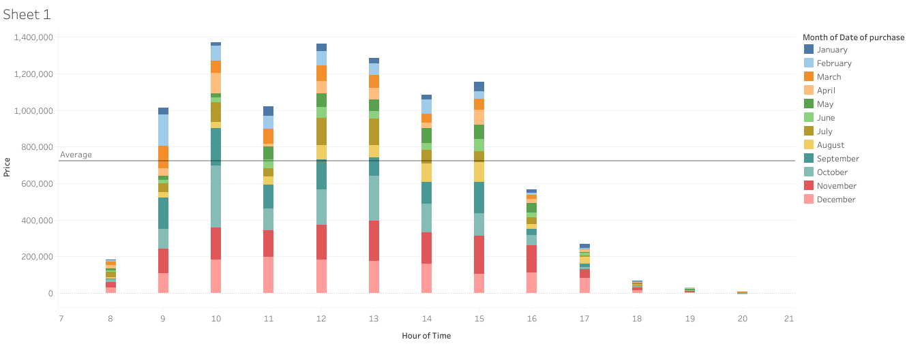
Bonus insight:
Highest sale hours
Mid- sale hours
Least sale hours
Least- sale hours
Above 785000 – Highest Sale hours
Between 200000 – 785000 Mid- sale hours
Below 200000 Least sale hours
For increasing the sales at mid- sales hours by assigning some extra discount deals/ offers.

Slide 21


